Slide 1
Technical Communication
Unit 5
© Copyright ABESEC Engineering College

Slide 2
Confidential Information
© (2021) ABES Engineering College.
This document contains valuable confidential and proprietary information of ABESEC. Such confidential and proprietary information includes, amongst others, proprietary intellectual property which can be legally protected and commercialized. Such information is furnished herein for training purposes only. Except with the express prior written permission of ABESEC, this document and the information contained herein may not be published, disclosed, or used for any other purpose.

Slide 3
Unit V
Dimensions of Oral Communication & Voice Dynamics:

Slide 4
Table of Content
UNIT-5
TOPIC-1
Code & Content
Stimulus & Response
Speaking with a Purpose
Speech and Personality
Pronunciation Etiquette
TOPIC -2
Professional Personality Attributes
TOPIC-3
Vowel sounds; Consonant sounds
Syllables;
Tone: Rising tone; Falling Tone

Slide 5
Important Terminologies
A ‘stimulus’ is anything that a person can receive through one of his senses.
In fact, it is anything that can produce a sensation.
A ‘response’ is anything that an individual does as a reaction to the stimulus.
These two terms, stimulus and response, are ultimately connected with the whole learning process.
.
Content in communication means any text matter of a document or publication in any form.
It can be defined as what is inside or included in something.
Content, like codes, has both element and structure.
A code may be defined as any group of symbols that can be structured in a way that is meaningful to another person.
Code is a system of rules to convert information into another form or representation.
Code
Content
Stimulus
Response

Slide 6
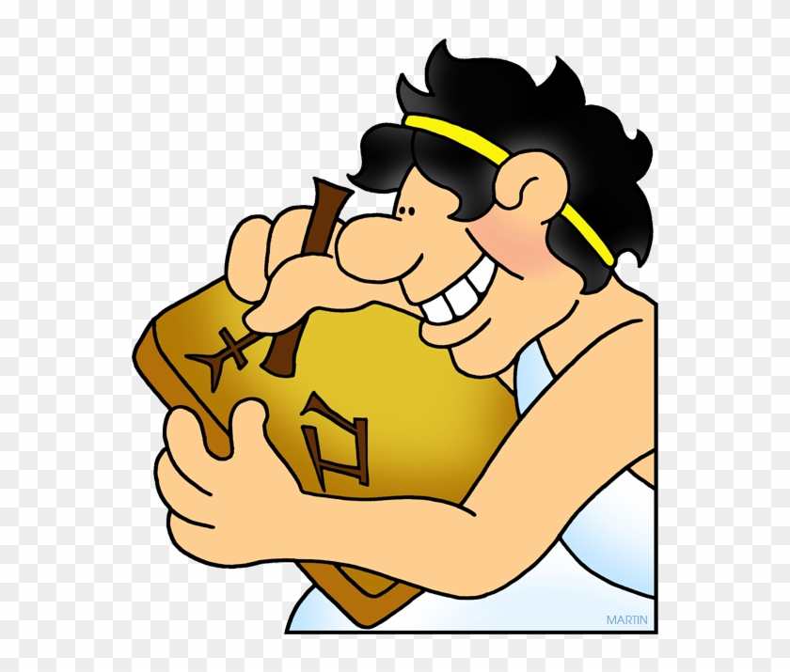
Code
Code : “ A group of symbols that can be structured in a way that is meaningful to another person.”
OR
Code is a system of Rules to convert information into another form or presentation.”
In a way all languages are codes.

Slide 7

Content
Content : “Text matter of a document or publication in any form.”
OR
Content is what is inside or included in something.
Example: Words inside a book

Slide 8
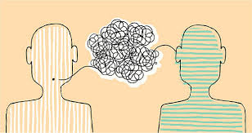
Stimulus and Response in Communication
Any Message or Information that evokes a response is Stimulus.
Response is defined as a rection to stimulus.
Communication is a two way process hence stimulus(message) caused by the sender leads to a response (reaction after receiving the message) by the receiver.

Slide 9
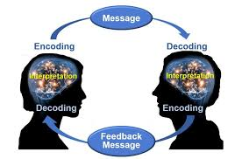
Encoding & Decoding
The sender Encodes his message i..e he translates in the form of symbols.
The listener or the receiver decodes the encoded message i..e he interprets the encoded message.

Slide 10
Encoding & Decoding
As language is a code, the encoding process is of vital importance.
What the sender wants to convey must be encoded correctly.
He must have a good vocabulary and good knowledge of grammar and syntax.
Any flaw might distort the meaning of the message he wants to convey.
Just as successful encoding is a skill, so is successful decoding.
Here the person decoding the message through a particular channel such as a letter, e-mail, telephone, etc., must be capable of deciphering or understanding that message.
He must have enough knowledge to understand that message.

Slide 11
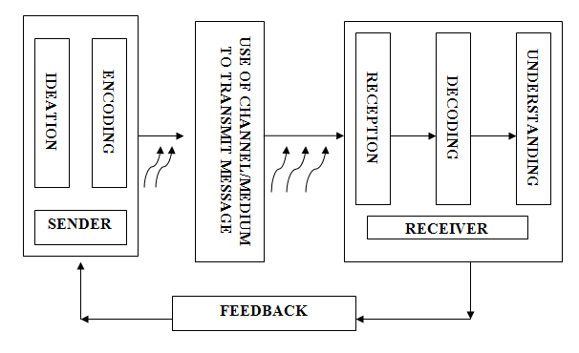
Process of Communication

Slide 12
Speaking with Purpose
1
TO INFORM.
2
TO ANALYZE.
3
TO INSTRUCT.
4
TO ENTERTAIN.
5
TO MOTIVATE
TO PERSUADE.
6

Slide 13
Tips for Effective Speaking
Before you speak, or write, take a second to pause and reflect on what your goal is.
Try to choose the most direct way to say what needs to be said.
Refuse to say umm, ahh or any other filler at any point. Take as much time as you need, just own every second you take.
If writing, read what you wrote before sending it. If it doesn’t flow easily when reading it, it needs to be re-written.
Read books and pay attention. When you hear something that sounds good to your ear, take note of it.
Take things one step at a time. Your goal is not to be a new man by tomorrow morning, it’s to become a bit of a better writer (or speaker) every day.
Use inclusive language for which apply “You-attitude”.
Adapt to the feedback you see from the audience.

Slide 14

Speech & Personality
In every aspect of our life, a good personality holds a very important value.
Whether you are a budding professional, an established career person, or perhaps a home-maker, it is something that will help you develop and maintain solid relationships with others.
One of the key facets of personality development is speech. This is the ability of a person to effectively communicate verbally.
Some people are gifted with verbal communication skills, while others are simply to shy and unsure of their abilities to even want to try.
Speech is important in so many ways; be it at home, at school, or at the workplace, you need to be able to articulate well the thoughts and ideas you have.

Slide 15
Speech & Personality
In personality development, the importance of speech is summed up into two:
Speech
Perception
Our perception of others can be influenced by the way they speak and the message they are trying to relay.
Expression
Being able to express ourselves through speech is essential to build relationships with people
Expression
. Perception

Slide 16
Pronunciation Etiquette
Make eye contact while speaking. This will give you confidence and will inspire others to listen to you.
Try to make your voice sound pleasing and soft.
Don’t speak in a monotonous voice; this might have a soporific effect on the audience. Change the modulation of your voice occasionally.
Even if you feel nervous, never show it to the audience; just slow down your speech and remain calm.
Don’t mumble. Speak clearly.
Use words the meanings of which are clear to you. This might save you from any embarrassment later.
Use proper body language to show your interest in the ongoing conversation.
At the end of the conversation, don’t forget the customary etiquette of thanking the audience for listening to you patiently.
All through the duration of a conversation, never do the following: think in your mother tongue what you want to say, then mentally translate it into English and finally speak in English. This will spoil the flow of your speech.

Slide 17
Thankyou

Slide 18
Topic-2
Professional Personality Attributes

Slide 19

Introduction
Personality means how people affect others, how they understand and view themselves, as well as their inner and outer measurable traits.
It primarily depends on their professional attributes and their values towards life.
Well developed aspects of personality play a vital role in determining overall professional success.

Slide 20
Professional Personality Attributes
Positive Attitude
Considerateness
Leadership
Assertiveness
Empathy

Slide 21
Professional Personality Attributes
Competence
Adaptability
Analytical Skill
Team Spirit
Observational Skills

Slide 22

Positive Attitude
It is the most important trait of a professional’s personality.
Your attitude to something is the way that you think and feel about it, especially when this shows in the way you behave.
If you are positive about things, you are hopeful and confident, and think of the good aspects of a situation rather than the bad ones.
It helps in reducing stress and seek other’s cooperation.

Slide 23

Empathy
Empathy is the ability to emotionally understand what other people feel, see things from their point of view, and imagine yourself in their place. Essentially, it is putting yourself in someone else's position and feeling what they must be feeling.
Having a great deal of empathy makes you concerned for the well-being and happiness of others. It also means, however, that you can sometimes get overwhelmed, burned out, or even overstimulated from always thinking about other people's emotions..

Slide 24
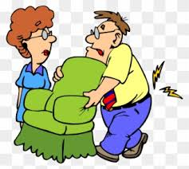
Considerateness
The civility of manners is a set of conventions that allows us, according to the philosopher Cheshire Calhoun, to “communicate basic moral attitudes of respect, tolerance and considerateness.”
It makes a professional caring so that the audience feel to be the part of their community and contribute positively.

Slide 25
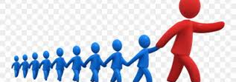
Leadership is both a research area and a practical skill encompassing the ability of an individual, group or organization to "lead", influence or guide other individuals, teams, or entire organizations.
Leadership quality equips the speaker with courage to face the challenges which require energy and positivity.
Leadership

Slide 26

Assertiveness
Assertiveness is the quality of being self-assured and confident without being aggressive. In the field of psychology and psychotherapy, it is a skill that can be learned and a mode of communication.
It enables the speaker to think in a positive manner about himself as well as about others.
This positive attribute keeps him free from all tensions just because he is ready to interact with others and seek their cooperation.

Slide 27

Competence is the set of demonstrable characteristics and skills that enable and improve the efficiency or performance of a job. The term "competence" first appeared in an article authored by R.W. White in 1959 as a concept for performance motivation.
It refers to a quality of possessing required skill, knowledge, qualification or capacity.
Competence

Slide 28
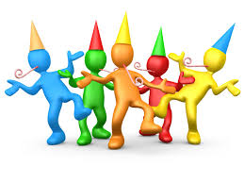
Team Spirit
Team spirit is the feeling of pride and loyalty that exists among the members of a team and that makes them want their team to do well or to be the best.
Team spirit is crucial to a work environment the stronger the team the stronger the company, by having strong team spirit among colleagues will boost motivation and will enable colleagues to feel a part of a team.

Slide 29
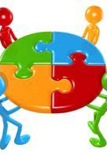
Adaptability
Being able to adapt to changing environments and work processes can be desirable traits to employers.
Having adaptability skills means you are open and willing to learn new things, take on new challenges and adjust suit transitions in the workplace.
Additionally, developing your adaptability can also mean developing other soft skills like communication and interpersonal skills.
Being adaptable in the workplace can be important when working on projects, developing strategies and implementing different approaches to doing your job. By showing your employers your adaptability skills, you are revealing how motivated you are to try new things and learn new skills.

Slide 30

Analytical Skills
Analytical skill is the ability to deconstruct information into smaller categories in order to draw conclusions.
Analytical skill consists of categories that include logical reasoning, critical thinking, communication, research, data analysis and creativity.
Analytical skill is taught in contemporary education with the intention of fostering the appropriate practices for future professions.
The professions that adopt analytical skill include educational institutions, public institutions, community organizations and industry.

Slide 31

Observational Skills
Analytical skill is the ability to deconstruct information into smaller categories in order to draw conclusions.
Analytical skill consists of categories that include logical reasoning, critical thinking, communication, research, data analysis and creativity.
Analytical skill is taught in contemporary education with the intention of fostering the appropriate practices for future professions.
The professions that adopt analytical skill include educational institutions, public institutions, community organizations and industry.

Slide 32
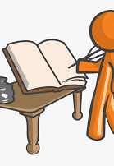
Conclusion
Finally, it is evident that one’s behaviour style plays an important part in social exchanges in in a social gathering as it governs interpersonal relationships upon which lies the success of an individual as a professional.

Slide 33
Thankyou

Slide 34
Topic-3
Vowel sounds; Consonant sounds
Syllables;
Tone: Rising tone; Falling Tone

Slide 35
Phonetics
Vowels & Consonant Sounds
Scientific Study
Pronunciation
Transcription
01
Phonetics
03
Pronunciation
Phonetics is the scientific study of SOUND system of languages.
Standard form of Spoken English
Documented in dictionaries for reference
02
Vowel & Consonant sounds
04
Transcription
12 Pure Vowel Sounds & 24 Consonant Sounds
* Dipthongsh
We have a standard form of Written English all over the world.

Slide 36
INTRODUCTION
Phonetics: Study of sound
Morphology: Study of word formation
Syntax: Study of sentence formation
Semantics: Study of Meaning
Discourse: Connected speech
Lexicography: Dictionary

Slide 37
What is the significance of Phonetics?
Multinational Companies
Diverse work cultural
Call Center jobs
Cross Cultural Communication
IELTS exams for Higher Studies
International Business & customers

Slide 38
Sounds of RP
In English (R.P), there are 44 distinctive sounds. Twenty of these are vowel sounds and the remaining 24 are consonants sounds.
44 sounds
20 vowels
12 pure vowels
8 diphthongs
24 consonants

Slide 39
International Phonetic Alphabet (IPA)
The International Phonetic Alphabet (IPA) is a set of symbols that linguists use to describe the sounds of spoken languages.
The aim of the International Phonetic Alphabet (IPA) was to provide a unique symbol for each distinctive sound in a language—that is, every sound, or phoneme, that serves to distinguish one word from another.

Slide 40
Concept of Pronunciation in RP
Spelling & Pronunciation: There is no one to one relation between the spelling of a word and its pronunciation.
Ex. Pronunciation of ‘ch’ in words like ‘machine’,
‘chemistry’, ‘chair’.
Vowels are speech sounds in the production of which there is, in the pharynx and the mouth, no obstruction and no narrowing of a degree that would cause audible friction.
The consonants are mostly articulated via closure or obstruction in the vocal tract.

Slide 41
Consonant sounds of English
initially medially finally
1. /p/ pin spin keep
2. /b/ bin tubs club
3. /t/ tell stick light
4. /d/ day heads laid
5. /k/ keep skill stick
6. /g/ get jugs bag
7. /ʧ/ chin reached teach
8. / ʤ / joke hinged large
9. /m/ met smoke team
10. /n/ net snake tin
11. /ŋ/ rings sing
12. /l/ lot fling full

Slide 42
13 /f/ fan soft if
14. /v/ van leaves thief
15. /ɵ/ thin months bath
16./ð/ then clothes bathe
17. /s/ sip list less
18. /z/ zip loser buzz
19. /ʃ/ ship rushed hush
20. /ʒ/ measure rouge
21. /h/ hot behave
22. /r/ rot try
23. /w/ watt sweat
24. /j/ yatch tune

Slide 43
Vowel sounds of English
(Pure Vowels/Monophthongs)
initially medially finally
1. /i:/ east sheet key
2. /I/ it hit duty
3. /e / end send
4. /æ/ and sand
5. /a:/ art heart car
6. /ɒ/ ox fox

Slide 44
Vowel Sounds of English (continued)
initially medially finally
7. /ɔ:/ all ball saw
8. /U/ put
9. /u:/ ooze choose chew
10./∧/ up cup
11./з:/ earn learn stir
12. /ə/ ago police maker

Slide 45
Vowel sounds of English (continued) Diphthongs
13. /eɪ/ eight straight stay
14. /əʊ/ oak joke slow
15. /aɪ/ ice mice my
16./aʊ/ out shout how
17. /ɔɪ/ oil boil boy
18. /ɪə/ ears beard peer
19. /eə/ airs paired hare
20. /uə/ cured tour

Slide 46
Syllable
A syllable may be defined as a unit of sound with one vowel sound and with or without consonant sounds.
A syllable is the sound of a vowel (a, e, i, o, u) that is created when pronouncing a word.
A syllable is a part of a word that is pronounced with one uninterrupted sound.
A syllable is a unit of sound which can be pronounced with a single effort of the voice.
For example, the word water is composed of two syllables: wa and ter as we have to make two efforts to pronounce this word.

Slide 47
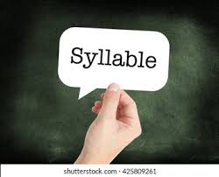
Syllable
i) word- one syllable, word
ii) spelling- two syllables, spe + lling
computer- three syllables com + pu + ter
The construction of a syllable may be described in terms of the following formula:
[C]+V=Syllable
Where C indicates indefinite number of consonants and V stands for a vowel sound, the bracket indicate that the consonants are not obligatory.
street = CCCVC (1 Syllable)
ago = VCV (2 Syllables)

Slide 48
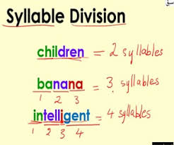
Types of syllable
Words are divided in to three types as per number of syllables:
Monosyllabic: Words with one syllable e.g. on- on (VC)
Disyllabic: Words with two syllables e.g. upon- up+ on (VCVC)
Polysyllabic: Words with more than two syllables e.g. syllable – sy+lla+ble (CVCVCVC)

Slide 49
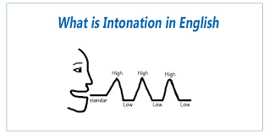
Intonation
The intonation in a language refers to the patterns of pitch variation or the tones it uses in its utterances.
In normal speech, the pitch of our voice goes on changing constantly – going up, going down, and sometimes remaining steady.
Different pitches of the voice combine to form patterns of pitch variation or tones, which together constitute intonation.

Slide 50
Intonation contours in English
In linguistics, intonation is the variation of pitch when speaking.
Intonation and stress are two main elements of linguistic prosody.
Intonation is the "music" of a language, and is perhaps the most important element of a good accent.
Often we hear someone speaking with perfect grammar, and perfect formation of the sounds of English but with a little something that gives them away as not being a native speaker.
Intonation — the rise and fall of pitch in our voices — plays a crucial role in how we express meaning.
Not all rises and falls in pitch that occur in the course of an English phrase can be attributed to stress. The same set of segments and word stresses can occur with a number of pitch patterns.
Consider the difference between:
You're going. (statement)
You're going? (question)
The rise and fall of pitch throughout is called its intonation contour.

Slide 51
Tone & Its Types
A unit of speech bounded by pauses has movement, of music and rhythm, associated with the pitch of voice.
This certain pattern of voice movement is called ‘tone’. A tone is a certain pattern, not an arbitrary one, because it is meaningful in discourse.
By means of tones, speakers signal whether to refer, proclaim, agree, disagree, question or hesitate, or indicate completion and continuation of turn-taking, in speech.
Types:
Fall
Low Rise
High Rise
Fall Rise

Slide 52
Fall (A Falling Tone)
A falling tone is by far the most common used tone of all.
It signals a sense of finality, completion, belief in the content of the utterance, and so on.
A speaker, by choosing a falling tone, also indicates to the addressee that that is all he has to say, and offers a chance (turn-taking) to the addressee to comment on, agree or disagree with, or add to his utterance.

Slide 53
Example
Consequences of his unacceptable behavior.
a) Ill report you to the HEADmaster
A falling tone may be used in referring expressions as well.
b) I've spoken with the CLEAner.
Questions that begin with wh-questions are generally pronounced witha falling tone:
c) Where is the PENcil?
Imperative statements have a falling tone.
d) Go and see a DOCtor.
Requests or orders have a falling tone too.
e) Please sit DOWN
Exclamations:
f) Watch OUT!
Yes/No questions and tag questions seeking or expecting confirmation
g) You like it, DON'T you?
YEES.
Here itis used when itis sure that the answer is yes.
h) Have you MET him?
Yes.

Slide 54
Low Rise (A Rising Tone)
This tone is used in genuine
'Yes/No' questions where the speaker is sure that he does not know the answer, and that the addressee knows the answer.
Such Yes/No questions are uttered with a rising tone.
For instance, consider the following question uttered with a rising tone, the answer of which could be either of the three options:
Isn't he NICE
i) Yes.
ii) No.
iii) | don’t know.
Compare the above example with the following example, which is uttered with a falling tone, and which can only have one appropriate answer in the context:
a) Isn't he NICE
b) YES.
Other examples which are uttered with a rising tone are:
Do you want some COFfee?
Do you take CREAM in your coffee?

Slide 55
High Rise (A Rising Tone)
If the tonic stress is uttered with extra pitch height, as in the following intonation units, we may think that the speaker is asking for a repetition or clarification or indicating disbelief. Examples-)
a) I'm taking up TAxidermy this autumn.
b) Taking up WHAT? (clarification)
c) She passed her DRIving test.
d) She PASSED? (disbelief)

Slide 56
Fall Rise
Fall-rise signals dependency, continuity, and non-finality. It generally occurs in sentence non-final intonation units.
Consider the following in which the former of the intonation units are uttered with a fall-rise tone (the slash indicates a pause):
Examples
i)Private enterPRISE / is always EF ficient.
ii) A quick tour of the Clty / would be NICE.
iii) PreSUmably / he thinks he CAN.
iv) Usually / he comes on SUNday.

Slide 57
Questions
The normal intonation contours for questions in English use final rising pitch for a Yes/No question
i) Are you coming today?
final falling pitch for a Wh-question
ii) When are you coming?
iii) Where are you going?
Using a different pattern typically adds something extra to the question.
E.g., Falling intonation on a Yes/No question can be interpreted as abruptness.
Rising intonation on a Wh-question can imply surprise or that you didn't hear the answer the first time and are asking to have it repeated.

Slide 58
Thankyou

